Slide 1
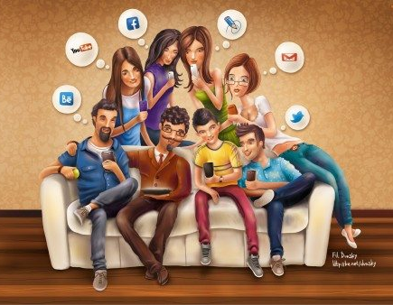
Social media Survey statistics
Evelyn phillippi

Slide 2
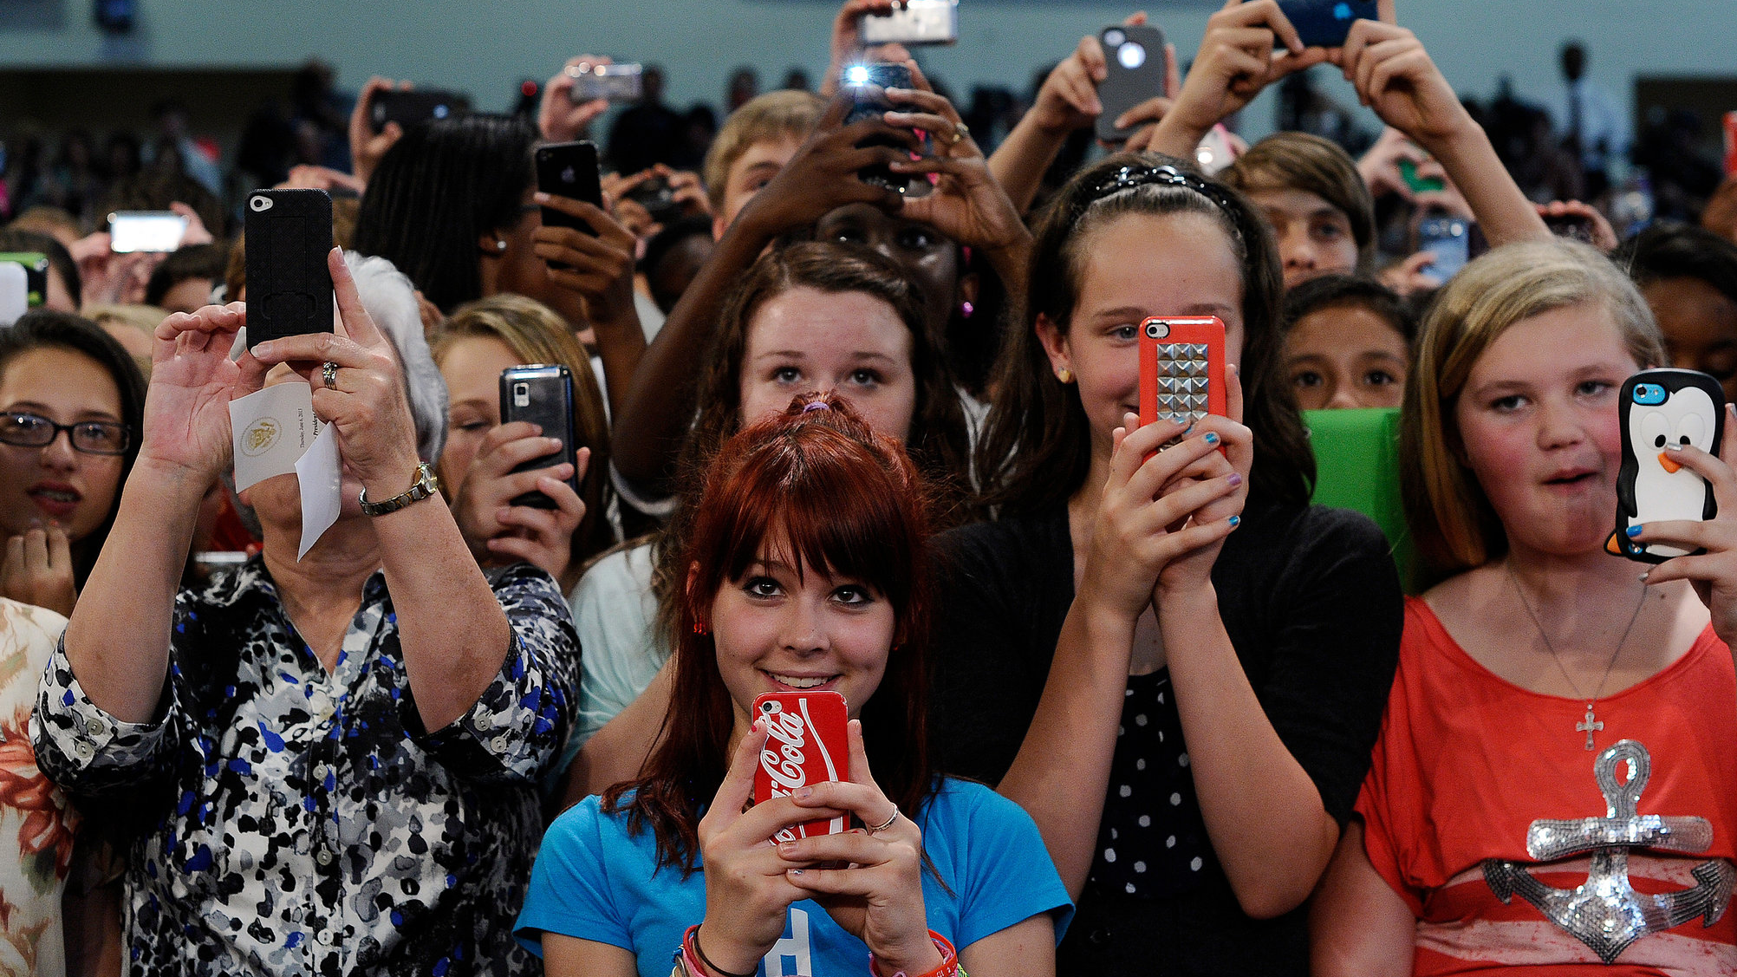
Ages 9-15
Got no data (am I surprised… no.)
Everyone I asked in this age group simply didn’t or refused to complete
Personal analysis: uses but aren’t aware or is too young to want to assess their technology use

Slide 3
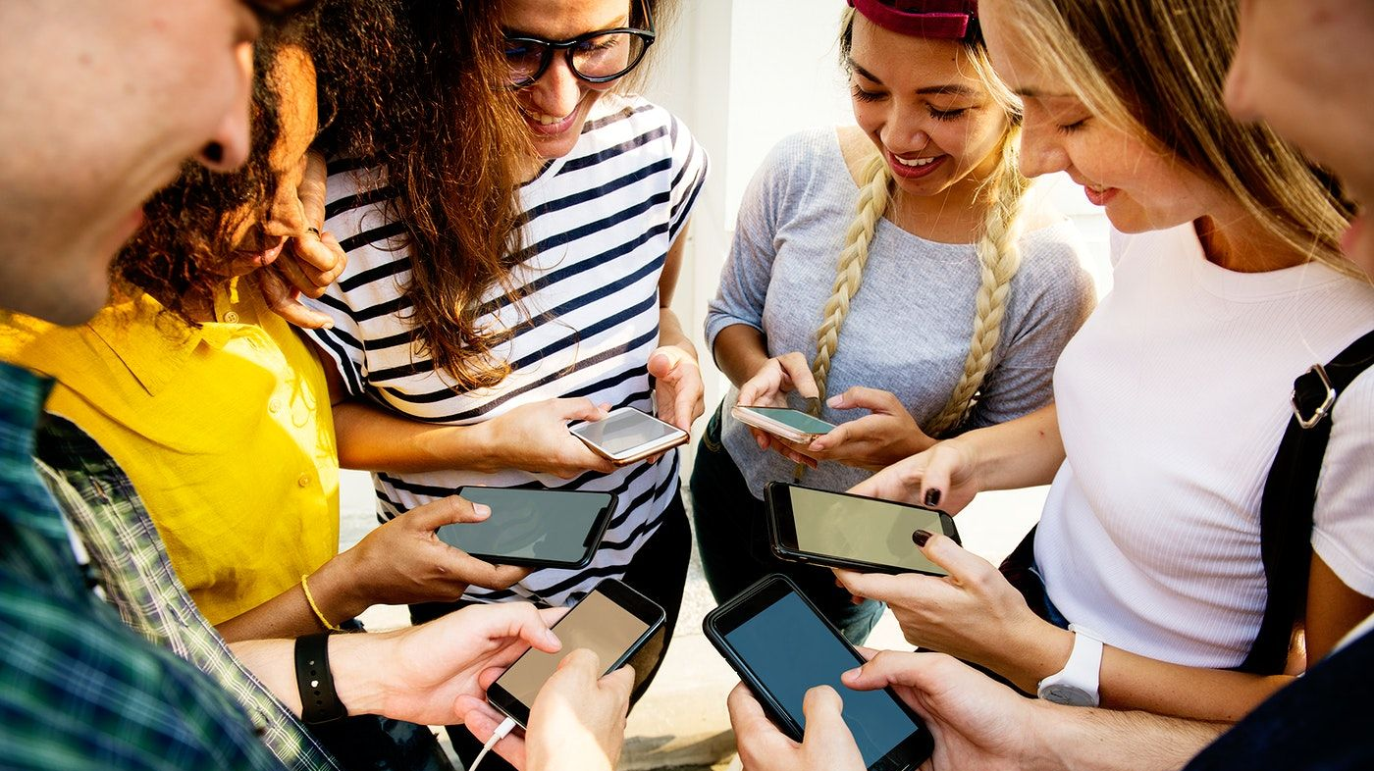
Ages 16-25
18 of 27 responses were of this group
Facebook, Instagram, and Snapchat were evenly popular
Twitter had a smaller amt of users-about 5 less than other avg
Most said 50-75% knew friends/followers personally
Common themes in open responses: “addictive”, “too much”, “useful”, “insecure”, “depressed”
Other medias mentioned- Discord and Tik Tok
Avg use time 4-6 hours a day

Slide 4
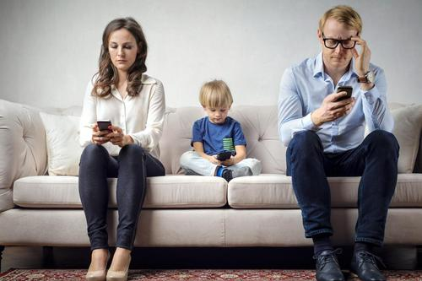
26-50
Facebook and Instagram were most popular with others rarely used
75-100% known personally
Common themes in open responses: “hardly use”, “ok”, “use wisely”
Avg usage time 1-2 hours a day
Other social media mentioned: LinkedIn

Slide 5
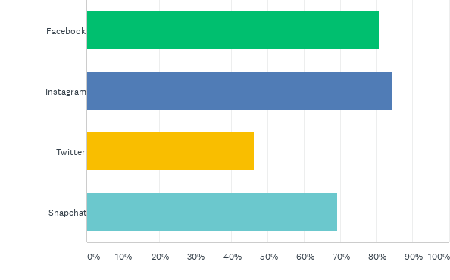
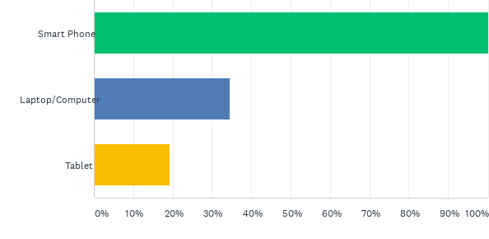
Data from survey overall
Social Sites Used
How Sites are Accessed

Slide 6
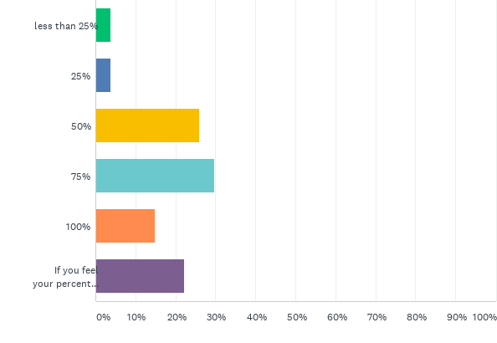
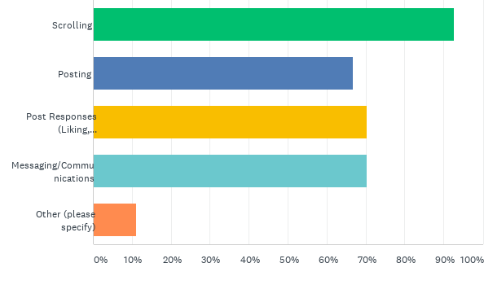
Data from survey overall
Site Behaviors
Percent of Followers/Friends Known Personally

Slide 7
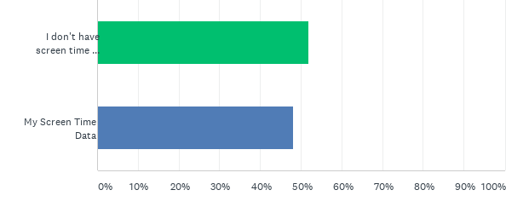
Gave screen time data vs. didn’t have

